Slide 1
Professional E-mails

Slide 2
Importance of Formal Emails
Email is a form of communication which is a reflection of you.
Professional emails permit you to keep the lines of communication for the purpose of keeping projects moving, making urgent decisions and other relevant purposes.
The communication is fast and seamless. No matter where you are in the world, as long as you have access to the internet, you will be able to send and receive emails.

Slide 3
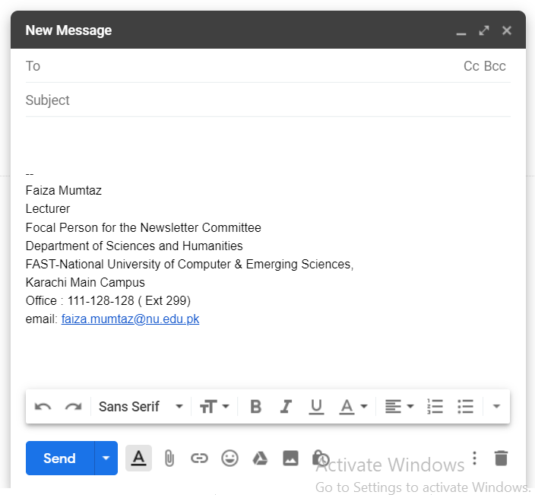
Components of Email
Heading
Subject line
Salutation
Body
closing

Slide 4
Heading
To:
Add only the people you expect a response from or have actions for in the To line.
CC:
Use CC line for recipients that need to know the content of the email but are not expected to respond, like those who need to be “in the loop”.
As a recipient, if you are on the CC line, do not reply to the email, you’re not expected to. However, if you see something odd or feel the need to add something to the email, reply to the sender directly (never reply-all) with your comments.

Slide 5
Heading
BCC:
Use the Bcc field very judiciously. Often it's best to forward an email separately, with a brief statement on why you're sending this information.
For security and privacy reasons, it is best to use the Blind Carbon Copy (BCC) feature when sending an email message to a large number of people.

Slide 6
Subject Line
It informs recipient what the email is about.
Never send an email without a subject.
Don’t use all caps or excessive punctuation.
Subject line should be:
Short
Meaningful
Clear

Slide 7
Subject Line
Note that it is a subject line, not a subject word. Single word subjects like “Question?” or “Hi” are useless in helping the recipient guess what the email is about.
Lead with the main idea Browsers may not display more than first 25-35 characters
Create single-subject messages

Slide 8
Ineffective subject lines
Subject
Hi
questions
Meeting
One more thing...........
Some thoughts
Out of town

Slide 9
Effective subject lines
Party planning meeting rescheduled for 3pm
Help: I can’t find the draft for the Smith Paper
Reminder: peer-review articles due tomorrow (3/30)
Questions about Sociology 210 project
Congratulations to Jennifer for winning Nobel Prize

Slide 10
Salutation
Always start with a greeting, an opener or a salutation.
It’s more polite, but really it sets the tone of the email.
A formal greeting, “Dear Mr Ahmed”, indicates a formal email;
a “Hi Hilton”, sets a more informal tone
Starting the email with, "Hey”, is too casual for most business situations because of the potential disrespect felt by some recipients.
Another salutation to avoid is, "To whom it may concern," unless you have absolutely no idea of the recipient's identity. This salutation suggests a blind email that does not have any relationship with the recipient.

Slide 11
Salutation
If the recipient is greeted by name at the start, they know the message is expressly for them and that a response is expected.
When you’re writing formal emails (such as cover letters or emails to a high-level superior), use Dear followed by the recipient’s honorific, last name, and a colon.
Dear Ms. Smith:

Slide 12
Salutation
Here’s a tip: If the recipient’s gender is unknown, or if their name is the least bit ambiguous, use a full name instead:
Dear Ishrat Hussain:
Here’s a tip: Avoid honorifics that imply marital status such as “Mrs.” Use “Ms.” instead.
Miz=ms.

Slide 13
Body of an Email
Before you type anything into a new message, have explicit answers for two questions:
1. Why am I writing this?
2. What exactly do I want the result of this message to be?

Slide 14
Body of an Email
Write emails that are easy to read
Make paragraphs 7-8 lines
Insert a blank line between paragraphs
Use headlines, bullets, and numbers
AVOID ALL CAPS; THAT’S SHOUTING
If a message is longer than 3 screens, send an attachment

Slide 15
Body: First Time Emails
It is good email etiquette to do two things:
properly introduce yourself
submit your full contact details.

Slide 16
Body of an Email
An email should contain only one topic.
Should be concise, brief, and no more than 4 paragraphs.
Make sure that each sentence is clear and adds to the content,
it does not repeat what has already been written.
Put the “bottom line” up front. If you are asking for something, ask up front, if you need something done, put the actions up front. Use the remaining body text to clarify the question, explain why you need something or to backup your points. This will also establish the email’s context and purpose for the recipient.

Slide 17
Body: Reply
If you are not in the To line, most certainly never reply-all.
If you are on the To line, still consider reply instead of reply-all.
If it is an invitation or you seek clarification, write to sender only.

Slide 18
Writing Style
Short paragraphs
Short and clear sentences
For actions, use active voice
Write grammatically correct sentences: spelling and sentence structure
Avoid humour
Beware of writing emails when angry or emotional.

Slide 19
Writing Style
When you are writing directions or want to emphasize important points, number your directions or bullet your main points.
For example,
Place the paper in drawer A.
Click the green “start” button.
Another example,
I have a couple of questions:
How can we improve customer satisfaction?
Will the proposal empower employees?

Slide 20
Writing Style- Tone
Write in a positive tone
“When you complete grading this assignment.”
instead of “If you ever finish grading … ”
Express your concerns or questions in a timely manner.
Using a professional tone when voicing concerns about grades or policies will be received more favorably than: “Why did I get this grade?????”

Slide 21
When Email Won’t Work
There are times when you need to take your discussion out of the virtual world and speak to the recipient in person.

Slide 22
Email closings for Formal Emails
Good email etiquette does require that you do have an end to the message, and that you do so as quickly and concisely as the rest.
1. Regards
Yes, it’s a bit stodgy, but it works in professional emails precisely
2. Sincerely
Sincerely conveys the right tone for formal correspondence. Keep in mind that it’s likely to come off as stuffy in more casual business emails.
3. Best wishes
A good blend of friendliness and formality makes this sign-off a safe bet, but be aware of its greeting-card vibe and use it only when it fits well with the tone of your email.

Slide 23
Email Closings for Friendly Business
4. Cheers
It works well if your email is friendly and conversational but, unless you’re actually British or Australian, it may come off as affected in more formal settings.
5. Best
It works well if your email is friendly and conversational but, unless you’re actually British or Australian, it may come off as affected in more formal settings.
6. As ever
This is a fine choice for people you’ve built an ongoing working relationship with. It reassures your contact that things are as good between you as they’ve ever been.

Slide 24
Signature
Use an appropriate signature
Brief (4-5 lines)
Informative
provide all contact information
Professional
do not include pictures, quotes, animations

Slide 25
Some Important Dos and Don’ts
1. Do not use email to share confidential information.
2. Take care with abbreviations and emoticons ☺
Save abbreviations like LOL (laugh out loud) or IDK (I don’t know) for text messages among friends.
Some may not understand your abbreviations
Not professional
3. THINK before you send
If you answer yes to all of these questions:
Is this relevant to the work my organization is doing?
Will the office benefit professionally from this information?

Slide 26
Some Important Dos and Don’ts
Do not send messages that provoke a strong emotional response from the receiver
Do not allow email to substitute for personal interaction

Slide 27
Class activity
Some employees have remarked to the boss that they are working more than other employees. Your boss has decided to study the matter by asking all employees to describe exactly what they are doing. If some jobs are found to be overly demanding, your boss may redistribute job tasks or hire additional employees.
Your task. Write a well organized email describing your duties, the time you spend on each task, and the skills needed for what you do. Provide enough details to make a clear record of your job. Use actual names and describe actual tasks. Describe a current or previous job. If you have not worked, report to the head of an organization to which you belong. Describe the duties of an officer or of a committee. Your boss or organization head appreciates brevity. Keep your email very precise and under one page.

